Slide 1
QUALITATIVE RESEARCH

Slide 2
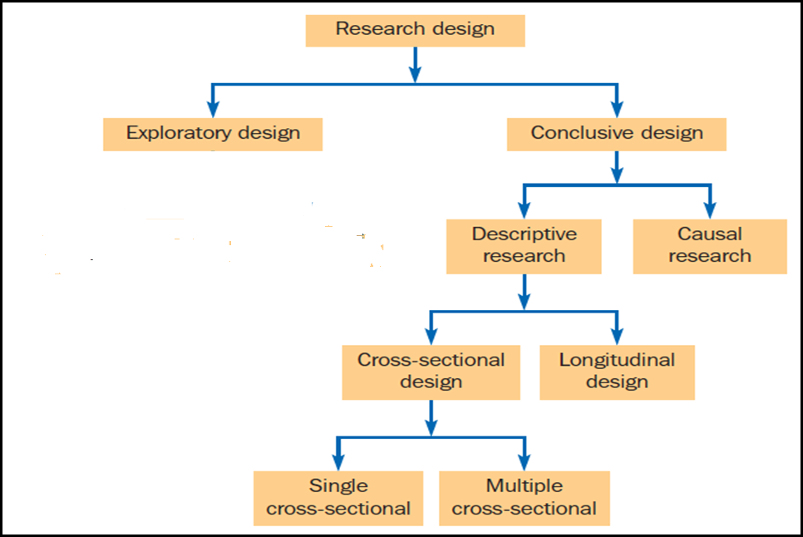
A CLASSIFICATION OF RESEARCH DESIGNS

Slide 3
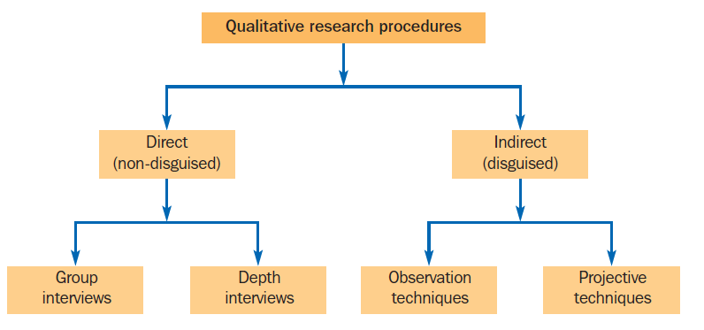
Important
Association Techniques
Completion Technique
Construction Technique
Expressive technique
A CLASSIFICATION OF QUALITATIVE RESEARCH TECHNIQUES

Slide 4
GROUP INTERVIEWS

Slide 5
FOCUS GROUP INTERVIEW
A focus group interview is an unstructured, free-flowing interview with a small group of people, usually between six and ten. Focus groups are led by a trained moderator who follows a flexible format encouraging dialogue among respondents.
A focus group takes advantage of the interaction between a small group of people. Participants will respond to and build on what others in the group have said. It is believed that this synergistic approach generates more insightful information, and encourages discussion participants to give more answers.
.

Slide 6
Focus group facilities typically include a comfortable room for respondents, recording equipment, and a viewing room via a two-way mirror.

Slide 7
DEPTH INTERVIEWS

Slide 8
DEPTH INTERVIEWS
A depth interview is a one-on-one interview between a professional researcher and a research respondent.
The interviewer’s role is critical in a depth interview. He or she must be a highly skilled individual who can encourage the respondent to talk freely without influencing the direction of the conversation. Probing questions are critical.
It is a qualitative interview and as such is based upon conversation, with the emphasis on researchers asking questions and listening, and participants answering.

Slide 9
OBSERVATION
Details in slides of observation

Slide 10
PROJECTIVE TECHNIQUES

Slide 11
A projective technique is an unstructured, indirect form of probing that encourages participants to project their underlying motivations, beliefs, attitudes or feelings regarding the issues of concern.
They are useful techniques for drawing out emotional values, and work by bypassing participants’ rational controls.
In projective techniques, participants are asked to interpret the behavior of others rather than to describe their own behavior. In interpreting the behavior of others, it is contended that participants indirectly project their own motivations, beliefs, attitudes or feelings into the situation.
Thus, the participants’ attitudes are uncovered by analyzing their responses to scenarios that are deliberately unstructured, vague and ambiguous.
These techniques are classified as association, completion, construction and expressive.

Slide 12
Association technique
A type of projective technique in which participants are presented with a stimulus and are asked to respond with the first thing that comes to mind.
Word association
A projective technique in which participants are presented with a list of words, one at a time. After each word, they are asked to give the first word that comes to mind.

Slide 13
Completion technique
A projective technique that requires participants to complete an incomplete stimulus situation.
Sentence completion
A projective technique in which participants are presented with a number of incomplete sentences and are asked to complete them.
Story completion
A projective technique in which participants are provided with part of a story and are required to give the conclusion in their own words.

Slide 14
Construction technique
A projective technique in which participants are required to construct a response in the form of a story, dialogue or description.
Picture response technique
A projective technique in which participants are shown a picture and are asked to tell a story describing it.
Cartoon tests
Cartoon characters are shown in a specific situation related to the problem. Participants are asked to indicate the dialogue that one cartoon character might make in response to the comment(s) of another character

Slide 15
Expressive technique
A projective technique in which participants are presented with a verbal or visual situation and are asked to relate the feelings and attitudes of other people to the situation.
Role playing
Participants are asked to assume the behavior of someone else or a specific object.
Third-person technique
A projective technique in which participants are presented with a verbal or visual situation and are asked to relate the beliefs and attitudes of a third person in that situation.
Personification technique
Participants are asked to imagine that the brand is a person and then describe characteristics of that person.

Slide 16
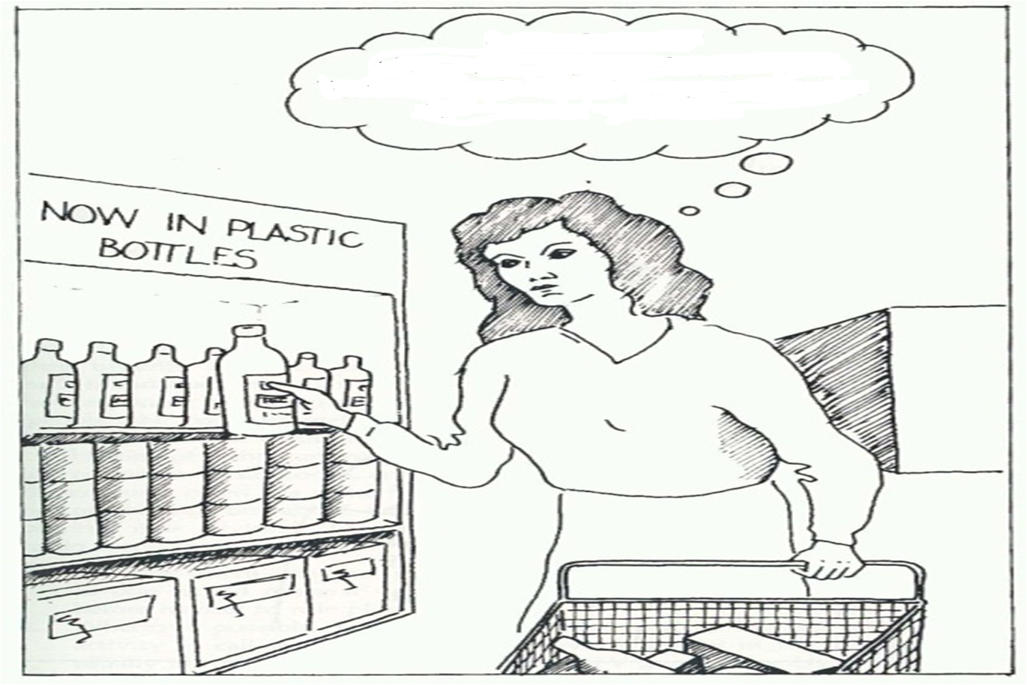
EXERCISE IS TO BE DONE INDIVIDUALLY
Imagine yourself in the place of the lady and write down your response below

Slide 17
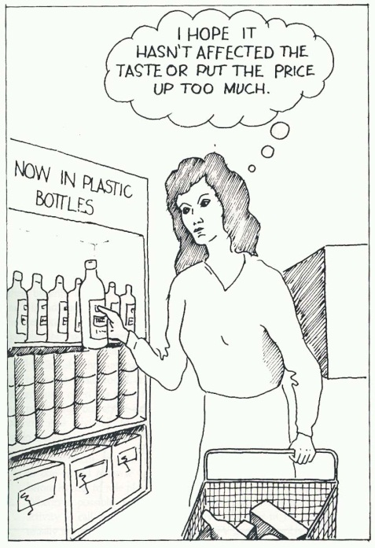

Slide 18


Slide 19
JBIMS
IIM A
ISB

Slide 20
THANK YOU

